Slide 1
Framingham Risk Score and PROCAM Reliability/ Validity Assessment using NHANES (2011-2016)

Slide 2

Introduction
Cardiovascular disease (CVD) leading cause of death in US (1 in 4 deaths)¹
Major risk factors: age, sex, smoking, hypertension, cholesterol, LDL-C, HDL-C, & diabetes
Other risk factors: obesity, family history of premature coronary heart disease
Identify “high-risk”
Numerous multivariable risk assessments
Framingham 10-year CVD risk score vs. PROCAM

Slide 3
Framingham 10-year CVD risk score (FRS)
First model developed to predict CHD in Framingham Heart Study sample
Variables : age, diabetes, smoking, blood pressure, cholesterol, LDL cholesterol ²
New model: 10-year risk of CVD
Variables: age, total cholesterol, HDL cholesterol, systolic blood pressure, antihypertensive medication use, current smoking status, diabetes status ³

Slide 4
Prospective Cardiovascular Münster Study (PROCAM) , 10-year CVD risk score
Point-scoring scheme developed in Germany ⁴
Men aged 35-65
Considers acute CHD event an endpoint
Variables : age, smoking, LDL cholesterol, HDL cholesterol, triglycerides, systolic blood pressure, diabetes mellitus, and family history of coronary heart disease

Slide 5

METHODS
Study, Measure Design & Statistical Analysis

Slide 6
Data Source and Study Design
National Health and Nutritional Examination Survey 2011-2016 ⁵
Stratified multi-stage sampling design
Data Collection: Interviews, physical examination and lab tests
Participants from 3 cycles were merged
Exclusion criteria:
Females
< 30 Years Old
n=14,124

Slide 7
Measurement of CVD
CVD
Coronary Heart Disease (CHD)
Congestive Heart Failure (CHF)
Stroke
Angina
Myocardial Infarction (MI)
Hypertension (HTN)
Dichotomized: Yes, if ever had a CVD condition/ Never
Questionnaire Data
Notes:
“Has a doctor or other health professional ever told you that you had (CHD, CHF, Stroke, Angina, MI, or HTN?”

Slide 8
CVD Risk Factors of FRS and PROCAM
FRS
Age (Years)
30-80 (5-year Interval)
HDL-c (mg/dL)
<35, 35-44, 45-49, 50-59, ≥60
Total Cholesterol (mg/dL)
<160, 160-199, 200-239, 240-279, ≥280
SBP (mmHg)
Treated
Untreated
<120, 120-129, 130-139, 140-159, ≥160
Smoking Status
Self-Reported
Fasting blood glucose levels
Diabetic: ≥126 mg/dL or hypoglycemic agent usage
Non-Diabetic: <126 mg/dL or no hypoglycemic agent usage
PROCAM
Age (Years)
35-65 (5-year Interval)
HDL-c (mg/dL)
<35, 35-44, 45-49, 50-59, ≥60
LDL-c (mg/dL)
<100, 100-129, 130-159, 160-189, ≥190
Triglycerides (mg/dL)
<100, 100-149, 150-199, ≥200
SBP (mmHg)
<120, 120-129, 130-139, 140-159, ≥160
Smoking Status
Self-Reported
Diabetes
Self-Reported
Familial History of Myocardial Infarction
Self-Reported

Slide 9
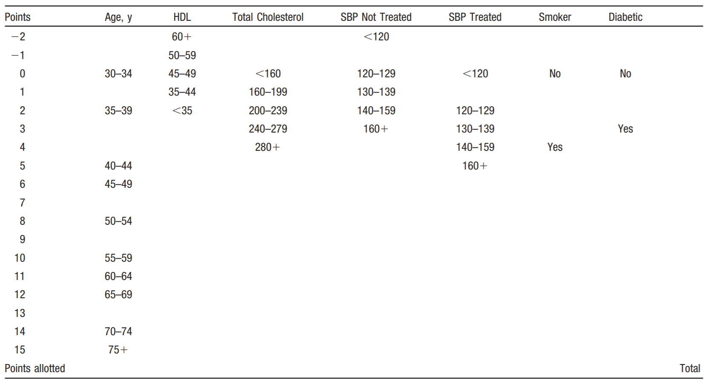
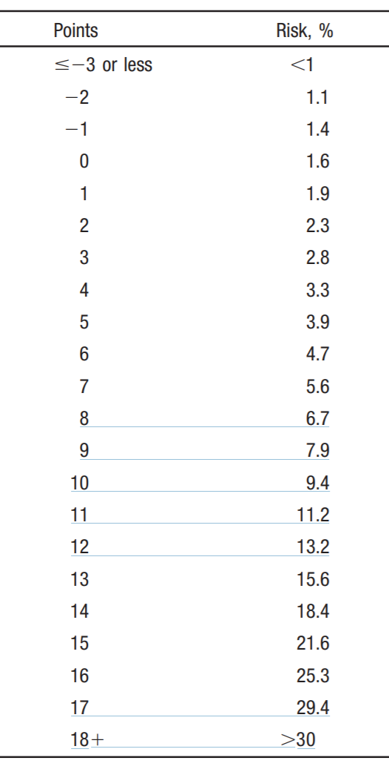
Risk Scoring System for FRS
D Agostino et. al, 2008
Low CVD Risk: <10%
Moderate CVD Risk: 10-19%
High CVD Risk: ≥20%
D Agostino et. al, 2008

Slide 10
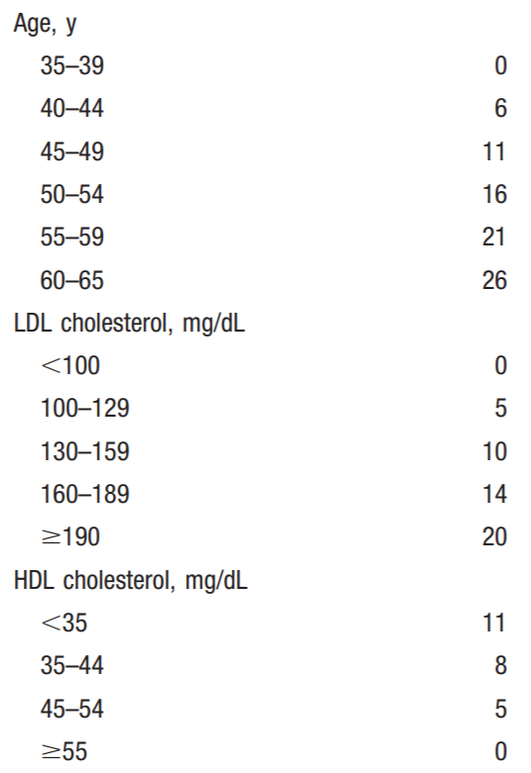
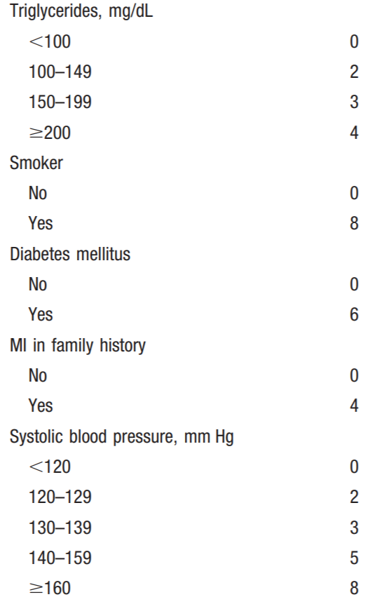
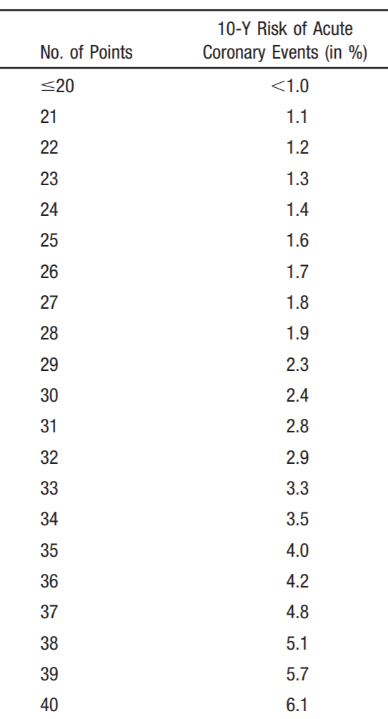
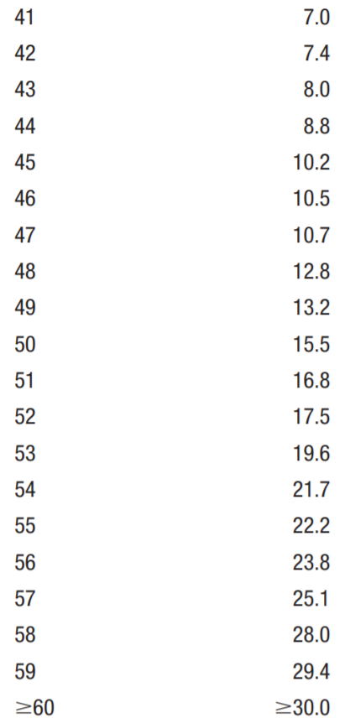
Risk Scoring System for PROCAM
Assmann et. al, 2002
Assmann et. al, 2002
Low CVD Risk: <10%
Moderate CVD Risk: 10-19%
High CVD Risk: ≥20%

Slide 11
Statistical Analysis
Chi-square was conducted between CVD and sociodemographic/ clinical variables
Internal consistency → FRS and PROCAM assessed through Cronbach’s Alpha
Construct Validity → Pearson’s pairwise correlation between CVD individual items for both FRS and PROCAM
Criterion Validity → Logistic regression between CVD and individual items for both FRS and PROCAM
Chi-Square used to assess reliability between scale results on detecting CVD risk in non-CVD risk population
Evaluating absolute agreement between FRS and PROCAM in measuring CVD risk → κ statistics (Cohen’s Kappa, Percent overall agreement)
Notes:
κ statistics were conducted to analyze Cohen’s Kappa and overall percent agreement between results of FRS and PROCAM measuring CVD risk in non-CVD populations to observe whether both scales would provide comparable results

Slide 12
Results

Slide 13
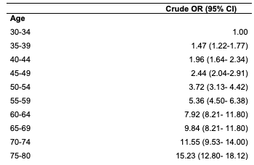
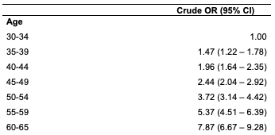
Results - Criterion Validity
Framingham
PROCAM

Slide 14
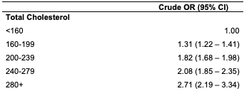
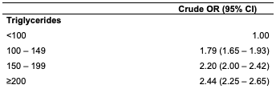

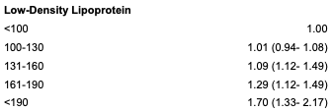
Results - cont.
Framingham
PROCAM

Slide 15
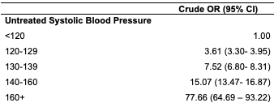
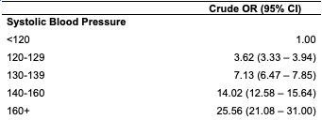
Results - cont.
Framingham
PROCAM

Slide 16
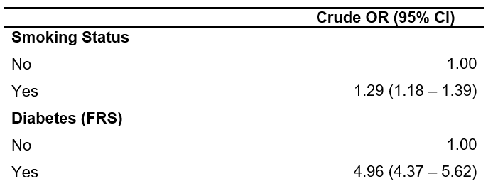
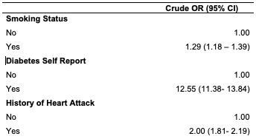
Results - cont.
Framingham
PROCAM

Slide 17
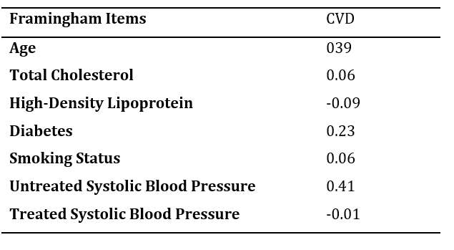
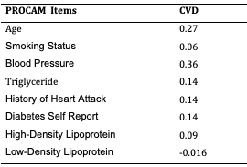
Results - Construct Validity
Framingham
PROCAM

Slide 18
Results:
Reliability - Cronbach’s alpha
Framingham: 0.318
PROCAM: 0.22
Kappa - Agreement
Cohen kappa: 0.13
Overall agreement: 0.74

Slide 19
Discussion
74% and Cohen’s kappa was 13%
Kappa results indicates FRS is more reliable
Our results was similar to the “Cardiovascular risk assessment in HIV-infected male patients: a comparison of Framingham and PROCAM”
(Mateja Pirs, 2014)

Slide 20
Why PROCAM Failed
Weighted Aged Differently
FRS
65 - 69 years
70 - 74 years
75 - 80 years
PROCAM
60 - 65 years

Slide 21
Cont
PROCAM: Low BP and medicated hypertensive participants having similar scores
Diabetes diagnosis is based on self-report

Slide 22
Limitations
No females in our study
NHANES only obtained fasting blood glucose from those who participated in the morning
Cross-sectional study, so it was difficult to determine the validity
Criteria available in NHANES for CVD
NHANES American population

Slide 23

REFERENCES
CDC, NCHS. Underlying Cause of Death 1999-2013 on CDC WONDER Online Database, released 2015. Data are from the Multiple Cause of Death Files, 1999-2013, as compiled from data provided by the 57 vital statistics jurisdictions through the Vital Statistics Cooperative Program. Accessed Feb. 3, 2015.
Wilson PWF, D’Agostino RB, Levy D, Belanger AM, Silbershatz H, Kannel WB. Prediction of Coronary Heart Disease Using Risk Factor Categories. CIRCULATION. 1998;(18):1837. http://proxy.library.nyu.edu/login?url=http://search.ebscohost.com/login.aspx?direct=true&db=edsbl&AN=RN043919581&site=eds-live. Accessed December 12, 2018.
D Agostino RB, Vasan RS, Pencina MJ, et al. General Cardiovascular Risk Profile for Use in Primary Care: The Framingham Heart Study. CIRCULATION. 2008;(6):743. http://proxy.library.nyu.edu/login?url=http://search.ebscohost.com/login.aspx?direct=true&db=edsbl&AN=RN224474773&site=eds-live. Accessed December 12, 2018.
Assmann G, Cullen P, Schulte H. Simple Scoring Scheme for Calculating the Risk of Acute Coronary Events Based on the 10-Year Follow-Up of the. Circulation. 2002;105:310-315. doi:10.1161/hc0302.102575
Centers for Disease Control and Prevention (CDC). National Center for Health Statistics (NCHS). National Health and Nutrition Examination Survey Data. Hyattsville, MD: U.S. Department of Health and Human Services, Centers for Disease Control and Prevention, 2015-2016 https://wwwn.cdc.gov/Nchs/Nhanes/2015-2016/DEMO_I.htm.
Pirs M, Jug B, Eržen B, et al. Cardiovascular risk assessment in HIV-infected male patients: A comparison of Framingham, SCORE, PROCAM and DAD risk equations. Acta Dermatovenerologica Alpina, Pannonica Adriat. 2014;23(3):43-47. doi:10.15570/actaapa.2014.11.

Slide 24

THANKS!
Any questions?

